Slide 1


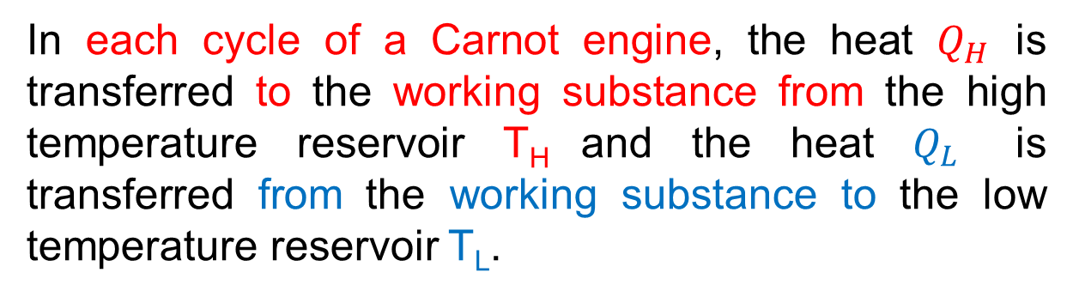
Lecture 11
Chapter 20: Entropy and the second law of thermodynamics
The Work:
In a Carnot engine, the working substance completes reversible cycles.
For a complete cycle of the working substance, the net internal energy change,
$$∆E_{int}=0$$
In each cycle of a Carnot engine, the heat $Q_{H}$ is transferred to the working substance from the high temperature reservoir T_{H} and the heat $Q_{L}$ is transferred from the working substance to the low temperature reservoir T_{L}.
So, the net heat transfer per cycle,
$$Q=\left|Q_{H}\right|−\left|Q_{L}\right|$$

Slide 2




The first law of thermodynamics for the Carnot cycle,
$$∆E_{int}=Q−W$$
$$0=Q−W$$
$$W=Q$$
$$W=\left|Q_{H}\right|−\left|Q_{L}\right|$$
This is the net work done by a Carnot engine during a cycle.

Slide 3
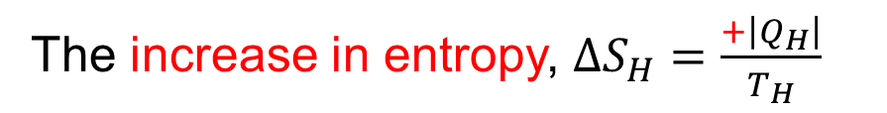

Entropy Changes:
There are two isothermal processes in each cycle of a Carnot engine.
During the isothermal expansion, the working substance absorbs heat $\left|Q_{H}\right|$ at temperature $T_{H}.$
The increase in entropy, $∆S_{H}=\frac{+\left|Q_{H}\right|}{T_{H}}$
Again during the isothermal compression, the working substance releases heat $\left|Q_{H}\right|$ at constant temperature $T_{L}$.
The decrease in entropy, $∆S_{L}=\frac{−\left|Q_{L}\right|}{T_{L}}$

Slide 4


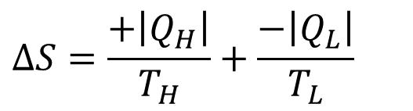
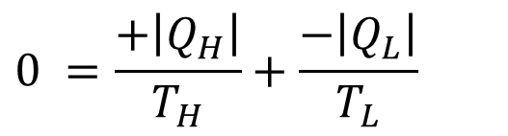
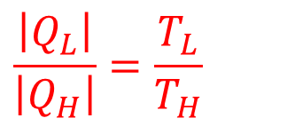
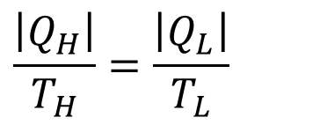
Thus the net entropy change per cycle,
$$∆S=∆S_{H}+∆S_{L}$$
$$∆S=\frac{+\left|Q_{H}\right|}{T_{H}}+\frac{−\left|Q_{L}\right|}{T_{L}}$$
For a complete cycle, $∆S=0$
$$0 =\frac{+\left|Q_{H}\right|}{T_{H}}+\frac{−\left|Q_{L}\right|}{T_{L}}$$
$$\frac{\left|Q_{H}\right|}{T_{H}}=\frac{\left|Q_{L}\right|}{T_{L}}$$
$$\frac{\left|Q_{L}\right|}{\left|Q_{H}\right|}=\frac{T_{L}}{T_{H}}$$

Slide 5
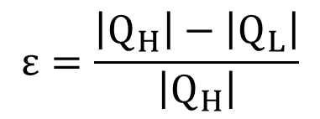
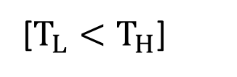
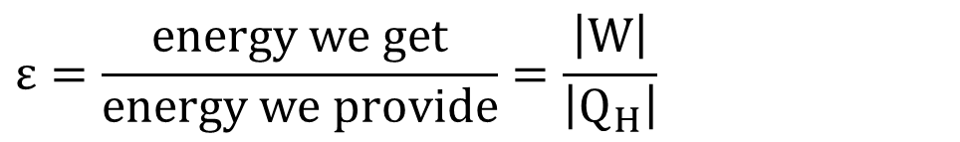

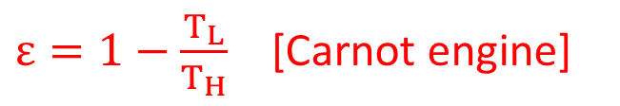
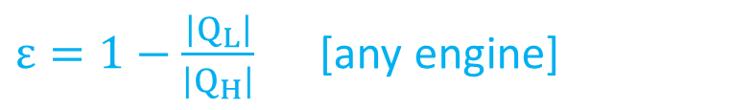
Efficiency of a Carnot Engine:
Thermal efficiency of any engine is defined as,
$$ε=\frac{energy we get}{energy we provide}=\frac{\left|W\right|}{\left|Q_{H}\right|}$$
$$ε=\frac{\left|Q_{H}\right|−\left|Q_{L}\right|}{\left|Q_{H}\right|}$$
$ε=1−\frac{\left|Q_{L}\right|}{\left|Q_{H}\right|}$ [any engine]
$ε=1−\frac{T_{L}}{T_{H}}$ [Carnot engine]
[$T_{L}<T_{H}$]
Because $T_{L}<T_{H}$, the efficiency of Carnot engine is less than unity or less than 100%. Thus only a part of the extracted heat is available to do work and the rest is delivered to the low temperature reservoir.

Slide 6

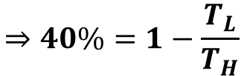
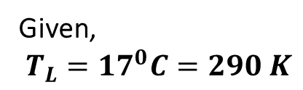



23. A Carnot engine whose low-temperature reservoir is at 17 ⁰C has an efficiency of 40%. By how much should the temperature of the high-temperature reservoir be increased to increase the efficiency to 50%?
Solution:
Given,
$$T_{L}={17}^{0}C=290 K$$
$$Initial efficiency, ε_{c}=40\%$$
$$Final efficiency, ε_{c}^{′}=50\%$$
$$∆T_{H}=?$$
For the initial state,
$$ε_{c}=1−\frac{T_{L}}{T_{H}}$$
$$⇒40\%=1−\frac{T_{L}}{T_{H}}$$

Slide 7
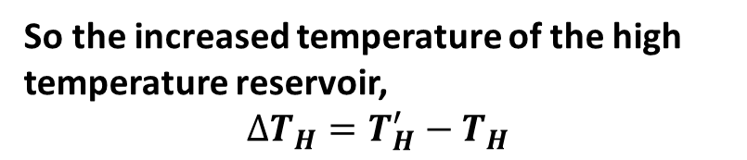


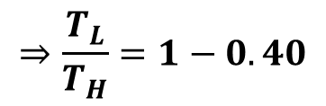
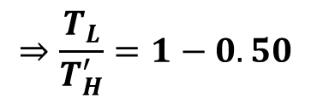
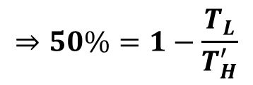

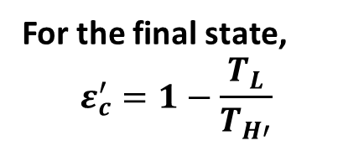

$$⇒\frac{T_{L}}{T_{H}}=1−0.40$$
$$∴T_{H}=483.33 K$$
For the final state,
$$ε_{c}^{′}=1−\frac{T_{L}}{T_{H′}}$$
So the increased temperature of the high temperature reservoir,
$$∆T_{H}=T_{H}^{′}−T_{H}$$
$$⇒50\%=1−\frac{T_{L}}{T_{H}^{′}}$$
$$=(580−483.33) K$$
$$⇒\frac{T_{L}}{T_{H}^{′}}=1−0.50$$
$$=96.67 K$$
$$∴T_{H}^{′}=580 K$$

Slide 8


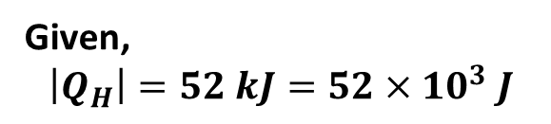
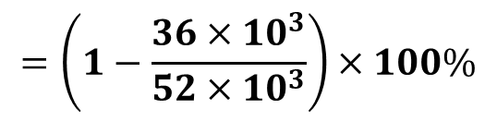
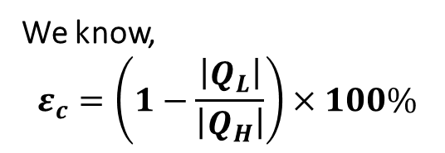

24. A Carnot engine absorbs 52 kJ as heat and exhausts 36 kJ as heat in each cycle. Calculate (a) the engine’s efficiency and (b) the work done per cycle in kilojoules.
Solution:
Given,
$$\left|Q_{H}\right|=52 kJ=52×{10}^{3} J$$
$$\left|Q_{L}\right|=36 kJ=36×{10}^{3} J$$
$${\left(a\right)ε}_{c}=?$$
We know,
$$ε_{c}=\left(1−\frac{\left|Q_{L}\right|}{\left|Q_{H}\right|}\right)×100\%$$
$$=\left(1−\frac{36×{10}^{3}}{52×{10}^{3}}\right)×100\%$$
$$=30.77 \%$$

Slide 9
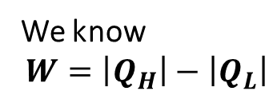



$$\left(b\right)W=?$$
We know
$$W=\left|Q_{H}\right|−\left|Q_{L}\right|$$
$$=52 kJ−36 kJ$$
$$W=16 kJ$$

